Slide 1
A mistery about ensemble and model distillation
Journal Club™️ production
Stefano Piazza – stefano.piazza@nagra.com

Slide 2
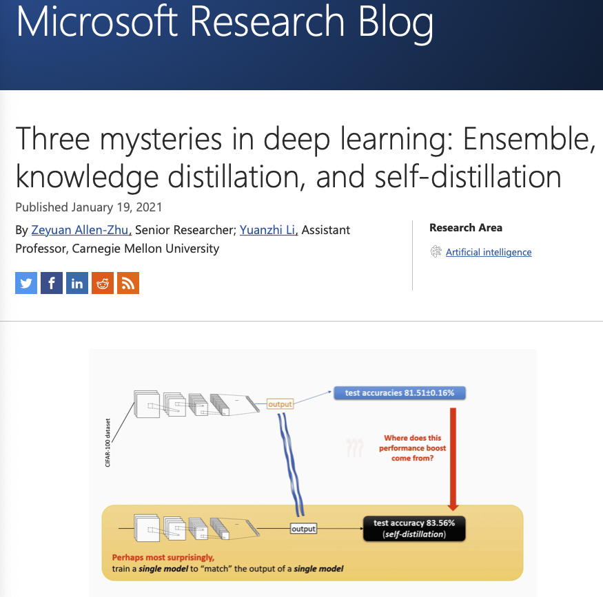
Inspiration
https://www.microsoft.com/en-us/research/blog/three-mysteries-in-deep-learning-ensemble-knowledge-distillation-and-self-distillation/

Slide 3
Setup
Identical models
Identical data
Different random seeds

Slide 4
Ensemble
P1
Consists in combining the predictions of different models to reduce the variance of the single models
Simplest way is to average the predictions
Traditionally, the more diverse the models the better if works, ie.
Use different models
Models with intrinsic randomization (ie. Forests)
Train models on random subset of features
data
pred
P2
AVG
P3

Slide 5
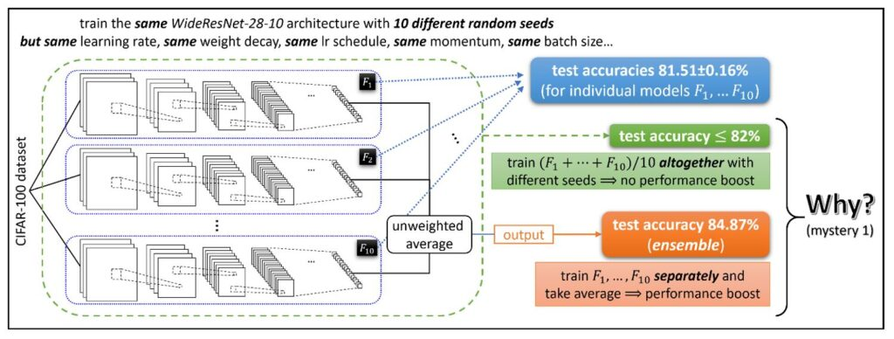
Mystery 1: Ensemble
In the DL realm:
Create an ensemble of:
identical models
trained separately on the same data
but with different random seeds
Obtain higher test set accuracy than:
Each individual model
The average of the prediction of the same models trained together (whatever it means…)

Slide 6
Knowledge distillation
TRAINING
Problem:
Ensemble are cool but require a lot of resources (store and execute several models for each predictions)
Solution:
Knowledge distillation: train a model to match the output of the ensemble
Normally, the distilled model is able to retain a part of the performance of a much bigger ensemble, while being much smaller
data
AVG
pred
Distilled model
PREDICTION
data
pred

Slide 7
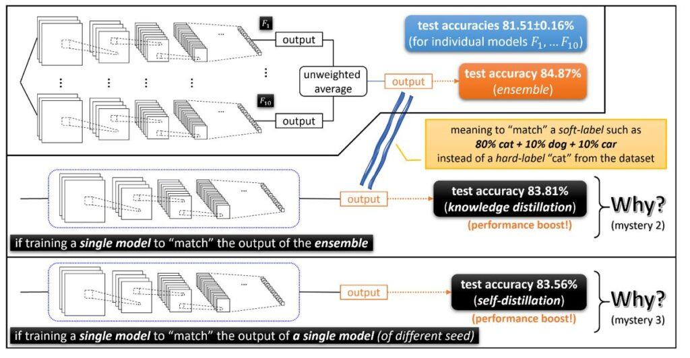
Mystery 2: Knowledge distillation
Take:
Another identical model
Trained on the output of the ensemble (the predicted probas of each class)
Obtain:
- Slightly lower accuracy than the ensemble
- Better accuracy than each individual model (!!)

Slide 8
Mystery 3: Self-distillation
And this also work if the model is trained of an ensemble of a single, identical model, with different seed!!

Slide 9
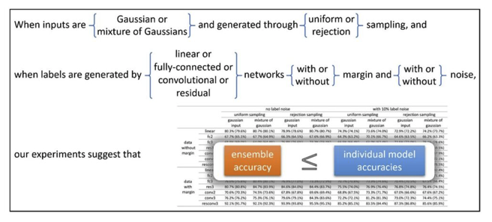
Is this always true?

Slide 10
But…
Does this work in tabular data?
Does this work at all??

